Slide 1

Operation Escape
Industry project group 2

Slide 2
The Elevator Pitch
Cooperative point and click escape room game where players must solve educational math puzzles in order to escape.

Slide 3
Problem Statement: Recap
There is a noticeable lack of games that are cooperative in nature on the active floor system.
Teachers working at primary schools that make use of ActiveFloor have noted that the older kids do not make use of the device often to advance their learning outcomes.
Notes:
There is a huge list of games with the 'co-op' tag, however they all possess competitive elements.
ActiveFloor is a small company and they do not possess too many resources that they can invest into making different style of games.

Slide 4
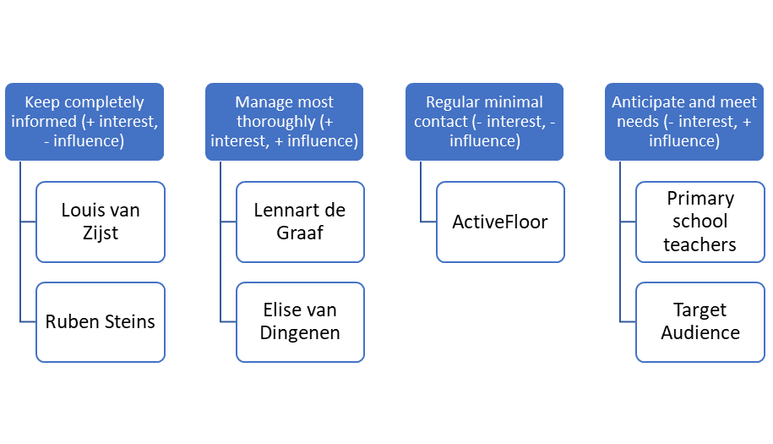
Analysis insight: Stakeholders

Slide 5
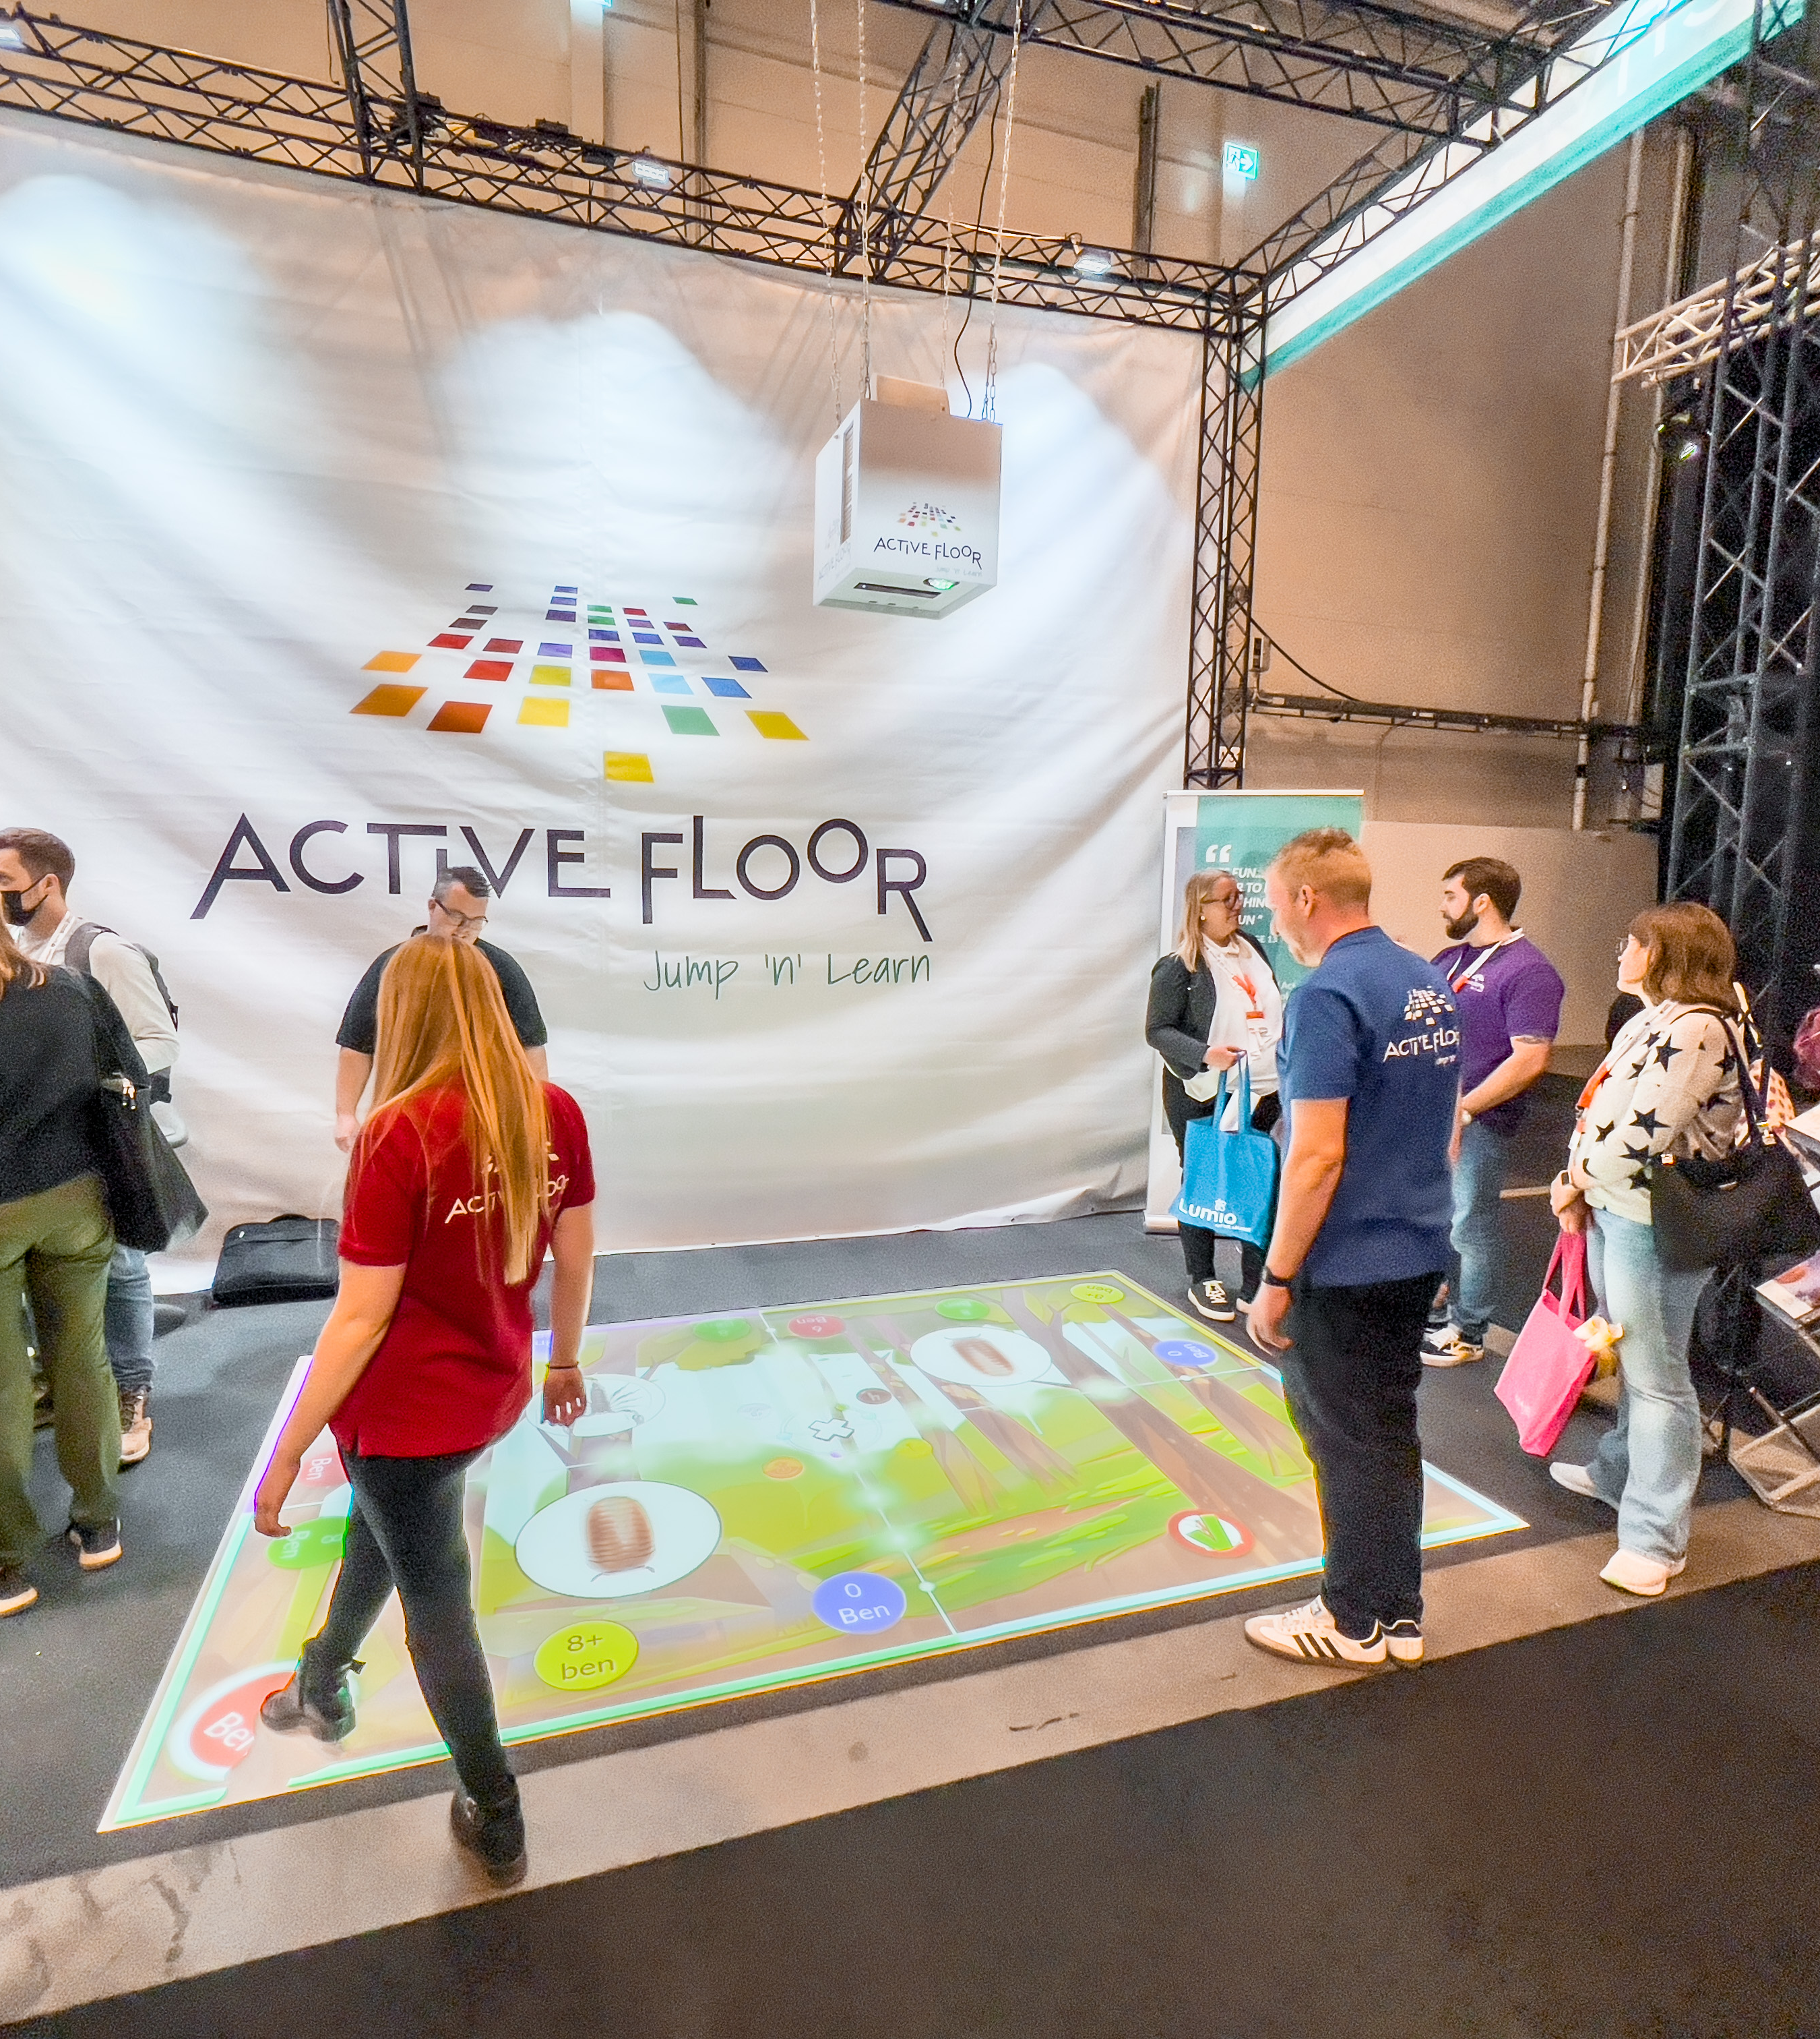
Analysis insight: Target users
Dutch primary school students, aged between 10 – 12 years old, who are enrolled at a school that make use of an ActiveFloor device.
Notes:
One such example is the Stichting Samenwijs de Vlinderakker. This is where we plan on working together with the students for playtesting etc.

Slide 6
Analysis insight: Domain
Game Design
Educational curriculum
Notes:
For game design we'll be taking a look at existing educational games and see what we can extract from those with what works and what doesn't.
Specifically math, for primary schools' grades 7 and 8
The required information regarding educational curriculum will be obtained through interviews with teachers, and library research online

Slide 7
Design challenge
We want to...
design an educational cooperative game for the ActiveFloor system that will provide an interactive environment for older Dutch primary school students so they can practice their math and teamwork skills during active school hours.

Slide 8

Intended type of fun
Fellowship: The game can only be played by 2 or more (up to 4) players. This means players must work together and discuss with each other to solve the puzzles correctly.
The puzzles will be designed so that every player must interact with the puzzle to solve it.

Slide 9
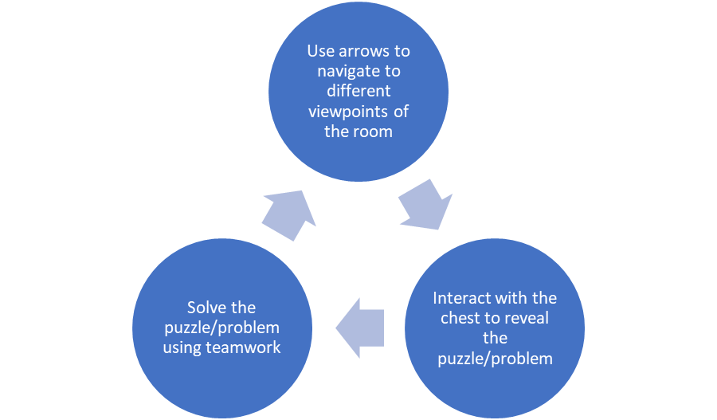
Core game loop
Notes:
This loop repeats until all the puzzles are solved and the players can escape, or until the timer runs out

Slide 10
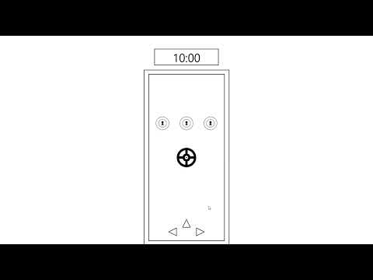
Prototype Video

Slide 11
In Conclusion...
There aren't enough math games that older Dutch primary school students find helpful.
There is a lack of actual cooperative games provided on the ActiveFloor system.
We are designing a game that aims to tackle both these problems.
Notes:
3. by designing an escape room-like puzzle game that focuses on math problems.

Slide 12
Questions?

